Slide 1
Milestone 4 – Data Analysis
Notes:
Hi there, my name is DB and I have got the honor of introducing SIMTECH to you. *click*

Slide 2
Agenda
1. Project overview
2. Data that we need (input, output, validation)
3. Data collection
4. Data analysis
5. Project budget
6. Project progress
7. Lessons learned
Milestone 4 – Data Analysis
Notes:
Here‘s Birds perspective, so that you can get a feeling for the task ahead
You can see how large this one is
And whwere some of the choke points are

Slide 3
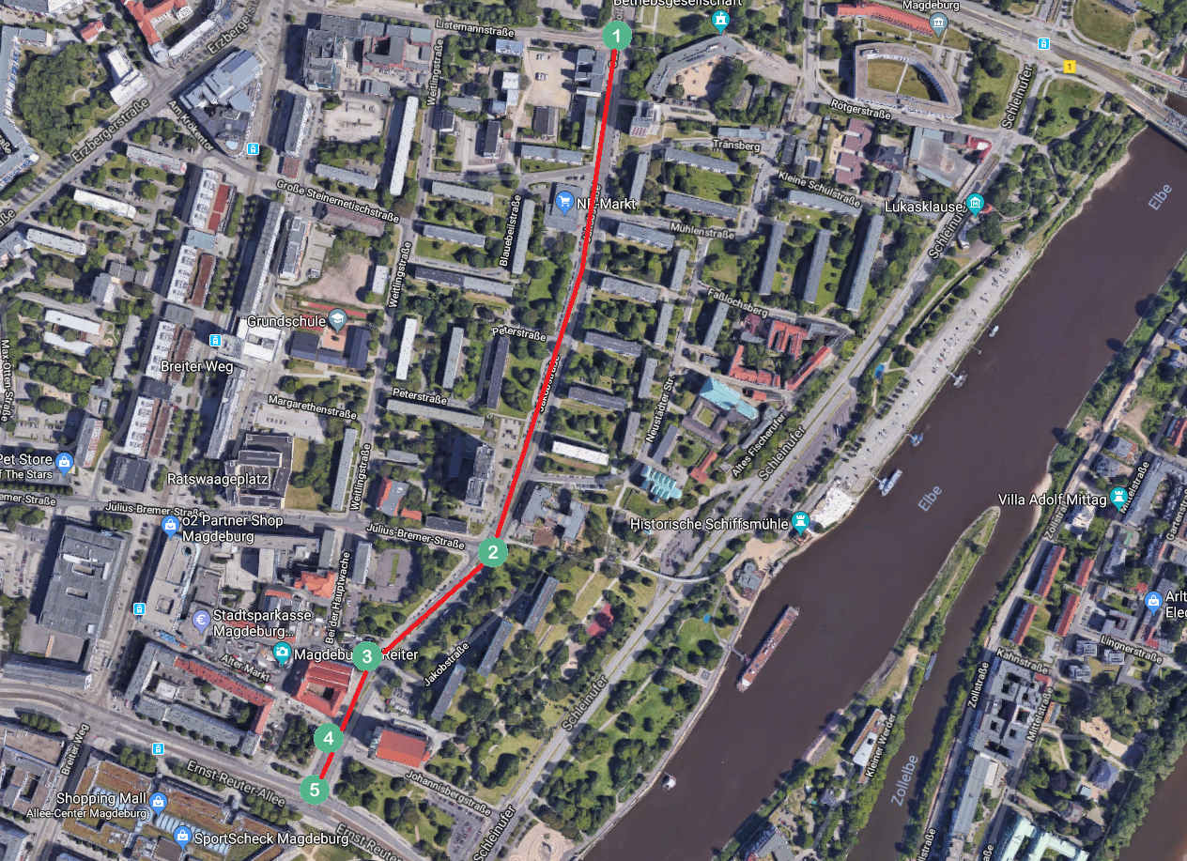
Project Overview - Revisited
Milestone 4 – Data Analysis
Notes:
Simply put: We want to create value for the customer – if we were real consultants, that would be the second highest priority.
First would be getting paid. But as we dont get paid, we still might learn something – getting better at working with strangers for instance, and creating our own frameworks to perform in. From scratch.
This is a sandbox, but an even better one than an internship (which you would do alone) And get grades.
This is what we want to achieve in theory. *click*

Slide 4
Input Data
Traffic volumes (number of cars going in and out of the system per hour) – for all important nodes (1, 2, 3, 4 and 5)
Turning probabilities in every possible direction – for inner nodes (2, 3 and 4)
Traffic lights signal timings (red/green timings, pedestrian interarrival time, pedestrian waiting time)
The length of the street and its segments between traffic lights and intersections
Speed limit for cars
Milestone 4 – Data Analysis
Notes:
So, who is SIMTECH? After much deliberation, we came up with the following distribution of roles, :
*fingerpointing* Sharath, main Conceptual modeler; Aleksei Baidarov, Pham Huu
Aleksei Baidarov,

Slide 5
Output and Validation Data
Time needed for getting from one entry/exit point to the the other (1->5 and 5->1)
Queue length at traffic lights (at the end of the red phase)
Milestone 4 – Data Analysis
Notes:
So, who is SIMTECH? After much deliberation, we came up with the following distribution of roles, :
*fingerpointing* Sharath, main Conceptual modeler; Aleksei Baidarov, Pham Huu
Aleksei Baidarov,

Slide 6
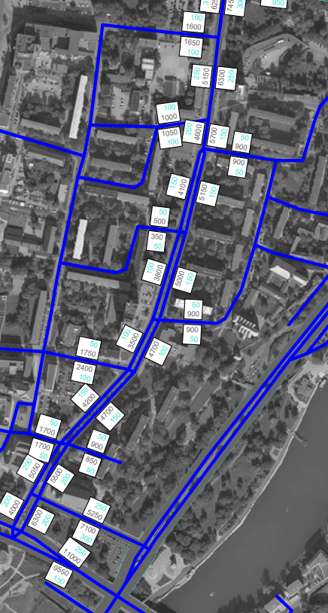
Data Collection
Data that we already have:
Volumes of traffic per 24 hours at Jakobstraße and all intersecting roads
Detailed (15-minutes intervals) statistics for nodes 2 (intersection with Julius-Bremer-Straße) and 4 (intersection with Johannisbergstraße)
Accidents statistics for 2017
Milestone 4 – Data Analysis
Notes:
So, who is SIMTECH? After much deliberation, we came up with the following distribution of roles, :
*fingerpointing* Sharath, main Conceptual modeler; Aleksei Baidarov, Pham Huu
Aleksei Baidarov,

Slide 7
Data Collection (cont. 1)
Data that we have collected:
Turning probabilities at node 3 (intersection with Bei der Hauptwache) for all possible directions
Traffic light timings at Listemannstraße intersection, near NP, at Julius-Bremer-Straße intersection and at Johannisbergstraße intersection (including pedestrian interarrival time and pedestrian waiting time)
The length of the street and its segments between traffic lights/intersections
Speed limit for cars
Milestone 4 – Data Analysis
Notes:
So, who is SIMTECH? After much deliberation, we came up with the following distribution of roles, :
*fingerpointing* Sharath, main Conceptual modeler; Aleksei Baidarov, Pham Huu
Aleksei Baidarov,

Slide 8
Data Collection (cont. 2)
Data that we still need to collect:
Time needed for getting from one entry/exit point to the the other (1->5 and 5->1)
Queue length at traffic lights
...
When:
This week
Milestone 4 – Data Analysis
Notes:
So, who is SIMTECH? After much deliberation, we came up with the following distribution of roles, :
*fingerpointing* Sharath, main Conceptual modeler; Aleksei Baidarov, Pham Huu
Aleksei Baidarov,

Slide 9
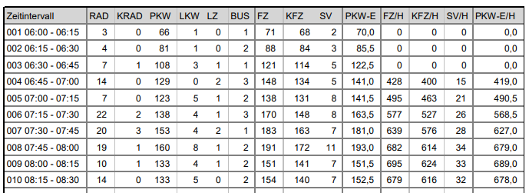
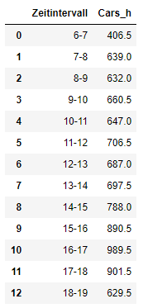
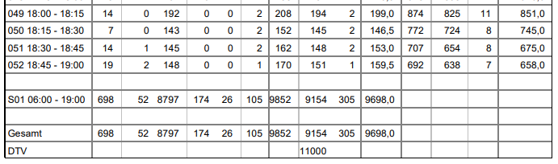
Data Analysis (Traffic volumes at nodes 2 and 4)
Cars = 0.5 * KRAD + 1.0 * PKW + 2.0 * LKW + 4.0 * LZ
Milestone 4 – Data Analysis
Notes:
So, who is SIMTECH? After much deliberation, we came up with the following distribution of roles, :
*fingerpointing* Sharath, main Conceptual modeler; Aleksei Baidarov, Pham Huu
Aleksei Baidarov,

Slide 10
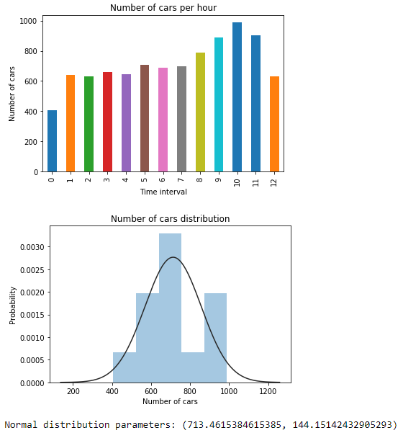
Data Analysis (Traffic volumes at nodes 2 and 4) (cont.)
Milestone 4 – Data Analysis
Notes:
So, who is SIMTECH? After much deliberation, we came up with the following distribution of roles, :
*fingerpointing* Sharath, main Conceptual modeler; Aleksei Baidarov, Pham Huu
Aleksei Baidarov,

Slide 11
Data Analysis (Traffic volumes at nodes 1, 3, 5)
DTV (Durchschnittlicher täglicher Vehrkehr) = 1.2 * Cars_13h
Cars_13h (Total number of cars from 6.00 to 19.00) = 0.833*DTV
We assume that from 6.00 to 19.00 number of cars has the following distribution:
Time Interval | 6 – 7 | 7 – 8 | 8 – 9 | 9 – 10 | 10 – 11 | 11 – 12
Fraction of cars | 0.045 | 0.068 | 0.065 | 0.070 | 0.071 | 0.075
12 – 13 | 13 – 14 | 14 – 15 | 15 – 16 | 16 – 17 | 17 – 18 | 18 – 19
0.073 | 0.075 | 0.085 | 0.098 | 0.108 | 0.075 | 0.073
Milestone 4 – Data Analysis
Notes:
So, who is SIMTECH? After much deliberation, we came up with the following distribution of roles, :
*fingerpointing* Sharath, main Conceptual modeler; Aleksei Baidarov, Pham Huu
Aleksei Baidarov,

Slide 12
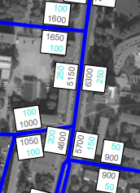
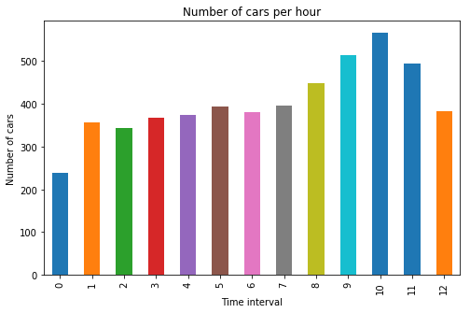
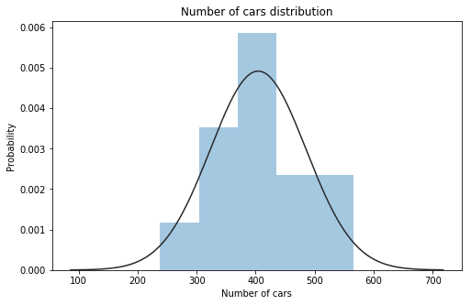
Data Analysis (Traffic volumes at nodes 1, 3, 5) (cont.)
Example:
DTV = 6300 Cars_13h = 0.833*6300 = 5248
Time | 6 – 7 | 7 – 8 | 8 – 9 | 9 – 10 | 10 – 11 | 11 – 12
Cars | 238 | 356 | 343 | 368 | 374 | 394
12 – 13 | 13 – 14 | 14 – 15 | 15 – 16 | 16 – 17 | 17 – 18 | 18 – 19
381 | 396 | 448 | 514 | 566 | 495 | 382
N (404.230, 81.105)
Milestone 4 – Data Analysis
Notes:
So, who is SIMTECH? After much deliberation, we came up with the following distribution of roles, :
*fingerpointing* Sharath, main Conceptual modeler; Aleksei Baidarov, Pham Huu
Aleksei Baidarov,

Slide 13
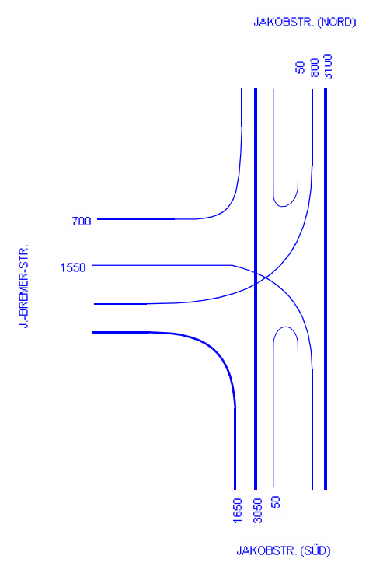
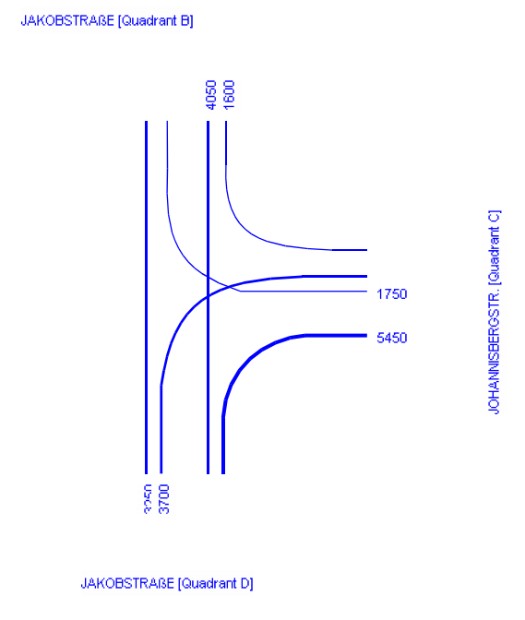
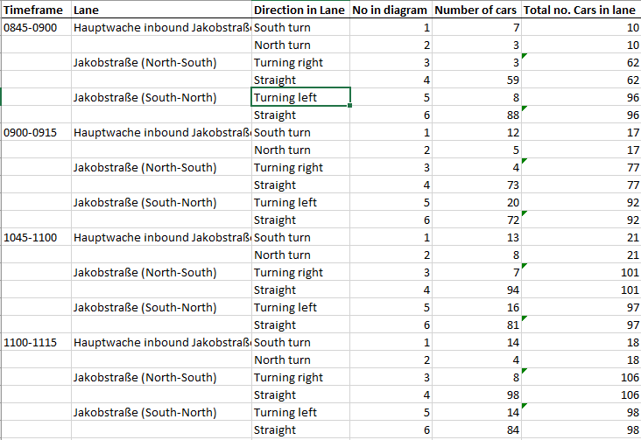
Data Analysis (Turning probabilities)
P (JNorth -> JSouth) = 0.803
P (JNorth -> Bremer) = 0.184
P (JNorth -> JNorth) = 0.013
P (JSouth -> JNorth) = 0.660
P (JSouth -> Bremer) = 0.330
P (JSouth -> JSouth) = 0.010
P (Bremer -> JNorth) = 0.327
P (Bremer -> JSouth) = 0.673
P (JNorth -> JSouth) = 0.650
P (JNorth -> Johannis) = 0.350
P (JSouth -> JNorth) = 0.426
P (JSouth -> Johannis) = 0.574
P (Johannis -> JNorth) = 0.302
P (Johannis -> JSouth) = 0.698
P (JNorth -> JSouth) = 0.936
P (JNorth -> Haupt) = 0.064
P (JSouth -> JNorth) = 0.849
P (JSouth -> Haupt) = 0.151
P (Haupt -> JNorth) = 0.303
P (Haupt -> JSouth) = 0.697
Milestone 4 – Data Analysis
Notes:
So, who is SIMTECH? After much deliberation, we came up with the following distribution of roles, :
*fingerpointing* Sharath, main Conceptual modeler; Aleksei Baidarov, Pham Huu
Aleksei Baidarov,

Slide 14
Data Analysis (Traffic lights)
Collected data:
Processed data:
Johannisbergstraße
Pedestrian interarrival time: 18, 66, 58, 51, 84, 3, 57, 30, 193, 186, 142, 192, 79, 55, 337, 238
Pedestrian waiting time: 67, 74, 52, 60, 83, 21, 4, 79, 22, 78, 3, 3
Green light: 13, 13, 13, 9, 10, 6, 9, 5, 6, 6, 15, 14, 8, 40, 14, 8, 12, 6, 6, 7, 6, 6
Red light: 75, 78, 74, 81, 102, 68, 105, 83, 75, 96, 99, 75, 37, 105, 75, 83, 69, 47, 87, 48, 81
Average pedestrian interarrival time = 87 sec
Average pedestrian waiting time = 32 sec
Average length of green signal = 11 sec
Average length of red signal = 78 sec
Julius-Bremer-Straße
Pedestrian interarrival time: 44, 166, 52, 18, 149, 21, 487, 136, 247, 113, 190, 97, 186, 31, 2, 89, 81, 202, 113, 104, 87, 39, 24, 107, 60
Pedestrian waiting time: 9, 15, 20, 18, 21, 30, 9, 34, 30, 27, 7, 24, 16, 14, 39, 14, 20, 5, 34
Green light: 17, 13, 18, 14, 12, 15, 19, 16, 12, 16, 10, 13, 13, 16, 12, 12, 14, 11, 13, 14, 11…
Red light: 63, 38, 38, 40, 38, 40, 40, 38, 37, 50, 39, 38, 68, 39, 41, 44, 47, 61, 61, 44, 38…
Near NP
Pedestrian interarrival time: 126, 184, 147, 36, 50, 31, 122, 135, 28, 54, 95, 55, 52, 59, 168, 68, 8, 66, 55, 117, 73, 110
Pedestrian waiting time: 6, 7, 8, 7, 28, 30, 7, 6, 32, 27, 8, 8, 14, 8, 7, 7, 7, 6, 7, 6, 9
Green light: 15, 16, 16, 17, 13, 17, 15, 16, 15, 15, 16, 16, 15, 16, 16, 14, 13, 16, 14, 14, 16
Red light: 111, 170, 130, 39, 39, 112, 119, 37, 33, 61, 39, 43, 37, 30, 52, 59, 40, 101, 58, 98
Listemannstraße
Pedestrian interarrival time: 80, 163, 39, 72, 97, 68, 1, 99, 67, 43, 206, 211, 23, 156, 64…
Pedestrian waiting time: 48, 70, 11, 59, 7, 35, 35, 12, 25, 3, 8, 57, 30, 66, 45, 19, 61, 10, 6, 45…
Green light: 13, 11, 10, 11, 11, 9, 10, 15, 11, 12, 10, 10, 9, 9, 8, 11…
Red light: 89, 92, 124, 73, 34, 85, 90, 28, 105, 32, 106, 73, 107, 90…
Milestone 4 – Data Analysis
Notes:
So, who is SIMTECH? After much deliberation, we came up with the following distribution of roles, :
*fingerpointing* Sharath, main Conceptual modeler; Aleksei Baidarov, Pham Huu
Aleksei Baidarov,

Slide 15
Assumptions and limitations
1. No bikes and buses.
2. Number of inbound cars = number of outbound cars for roads with low traffic volumes (Blaubeilstraße, Peterstraße, Mühlenstraße, Neustädter Str.), they do not have any influence on our model.
3. Turning probabilities are stable.
4. Traffic volume for 24 hours is 20% larger than traffic volume from 6.00 to 19.00.
5. Number of cars per hour has distribution as shown in slide 11.
Milestone 4 – Data Analysis
Notes:
So, who is SIMTECH? After much deliberation, we came up with the following distribution of roles, :
*fingerpointing* Sharath, main Conceptual modeler; Aleksei Baidarov, Pham Huu
Aleksei Baidarov,

Slide 16
Project Progress
Milestone 4 – Data Analysis
Notes:
So, who is SIMTECH? After much deliberation, we came up with the following distribution of roles, :
*fingerpointing* Sharath, main Conceptual modeler; Aleksei Baidarov, Pham Huu
Aleksei Baidarov,

Slide 17
Project Budget
Milestone 4 – Data Analysis
Notes:
So, who is SIMTECH? After much deliberation, we came up with the following distribution of roles, :
*fingerpointing* Sharath, main Conceptual modeler; Aleksei Baidarov, Pham Huu
Aleksei Baidarov,

Slide 18
Lessons Learned
Problem #1: Inability to make decisions, wasting much time discussing same things over and over again
Solution: Appeal to next level in hierarchy
Problem #2: Discussing details before agreeing on major points
Solution: Focus on big picture, discuss details later
Problem #3: Misconceptions about simulation subject
Solution: Scouting in person
Milestone 4 – Data Analysis
Notes:
So, who is SIMTECH? After much deliberation, we came up with the following distribution of roles, :
*fingerpointing* Sharath, main Conceptual modeler; Aleksei Baidarov, Pham Huu
Aleksei Baidarov,

Slide 19
Thank you!
Milestone 4 – Data Analysis
Notes:
So, who is SIMTECH? After much deliberation, we came up with the following distribution of roles, :
*fingerpointing* Sharath, main Conceptual modeler; Aleksei Baidarov, Pham Huu
Aleksei Baidarov,

